Slide 1

Influencing decision-making in health and wellbeing
Reflections from health impact assessments
in Auckland 2007-2010
Adrian Field
Kim Arcus
Megan Tunks
Paper presented to 2011 Australasian Evaluation Conference, 31 August – 2 September 2011
Notes:
Bay of Plenty Regional Policy Statement: Key policies
Also worth noting the issues regarding resource management issues of significance to iwi authorities:
Recognition of kaitiakitanga and Te Tiriti o Waitangi principles
Protection of tangata whenua environmental principles
Inclusion of tangata whenua in resource management decision making
Degradation of mauri
Developing Maori land
Recognition and provision for iwi/hapu resource management plans
Damage and destruction of special cultural sites

Slide 2
This presentation
What is Health Impact Assessment?
Background to four HIAs in Auckland
Approaches taken
Outcomes achieved
Drivers of influence

Slide 3
What is health impact assessment?

Slide 4
What is a Health Impact Assessment (HIA)?
Comprehensive review of the potential health effects of a policy, plan, programme or project
Analysis of evidence, data, and engagement with experts and decision-makers from multiple sectors
Includes a focus on the distribution – the different populations affected
Focus on health and wellbeing
Also, identifies options/recommendations to
  Enhance positive impacts
  Reduce/eliminate negative impacts
  Inform and support policy development and implementation
Influence and change for positive health outcomes
Build long-term monitoring frameworks

Slide 5
Steps in HIA
Local perspectives
Appraisal & Reporting
Scoping & Profiling
Evaluation & Monitoring
Screening
Literature/evidence

Slide 6
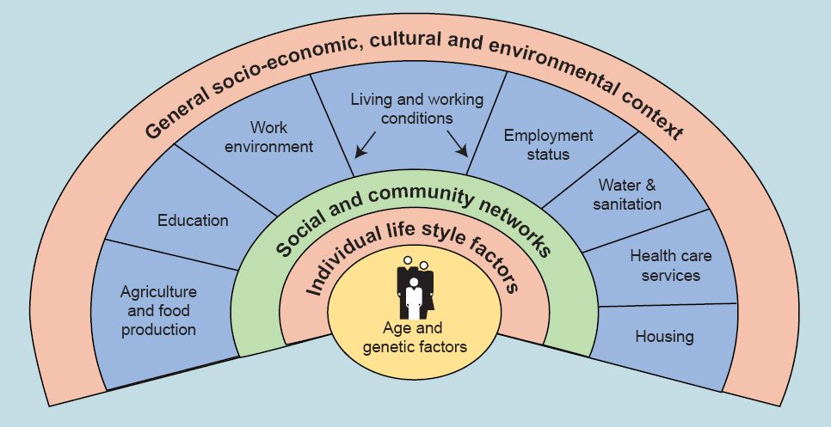
Determinants of health
Source: Dahlgren and Whitehead 1991

Slide 7
Background to Auckland HIAs

Slide 8
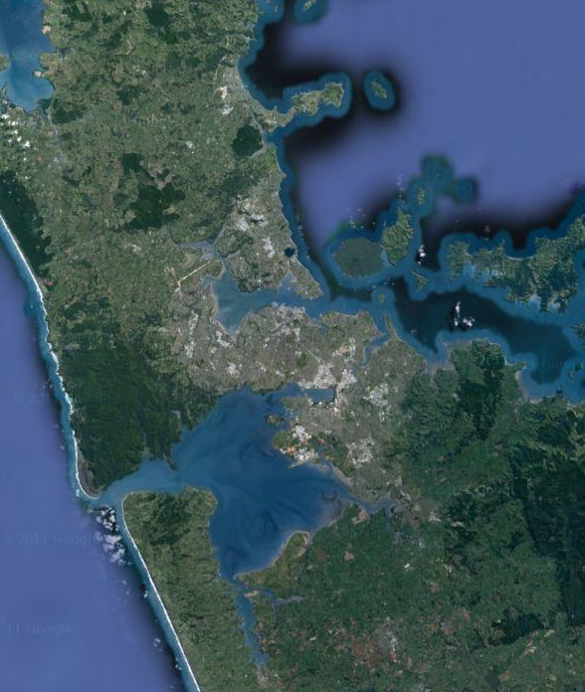
Auckland region
Four HIAs undertaken by Synergia and partners in the region
2007-2010
Housing development in Papakura
Long-term spatial plan for Manukau City Centre
Spatial plan for Wiri adjoining suburb to Manukau
Auckland Regional Transport Strategy (region-wide)
Rodney
North Shore
Waitakere
Central Auckland
Manukau
Papakura

Slide 9
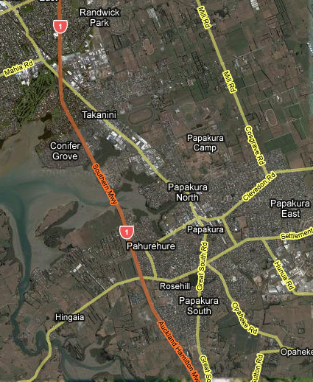
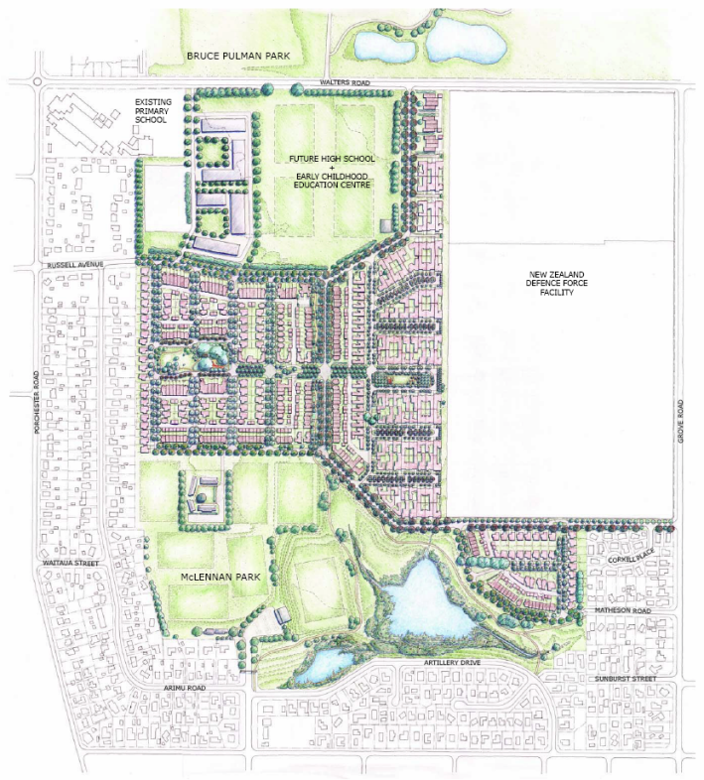


Papakura McLennan
Housing Development
450 dwellings intended to be developed
McConnell Property, in partnership with Housing NZ and Papakura District Council
Slow traffic principles, access to open space
Mixed tenure housing, with ‘pepper potting’ of HNZC
HIA conducted over 2007-08
Community cohesion, service access, walkability

Slide 10
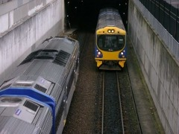
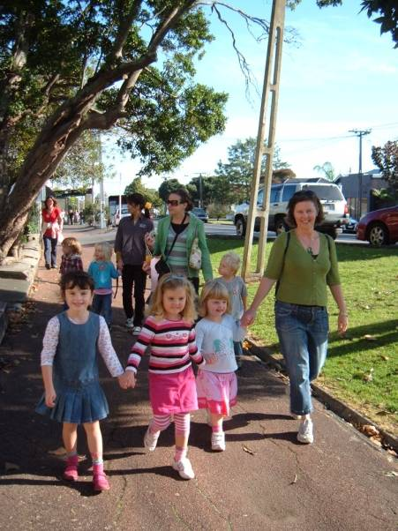
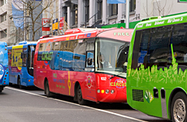

Auckland Regional Land Transport Strategy
Early stage of strategy
HIA to inform development
Review strategic options
Input ahead of public consultation
HIA conducted over 2008-09
Emissions, safety, access and mobility, active transport

Slide 11
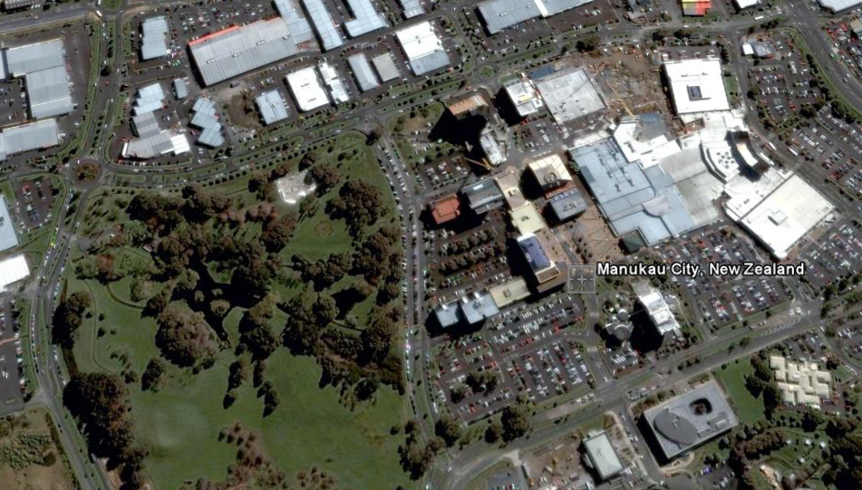
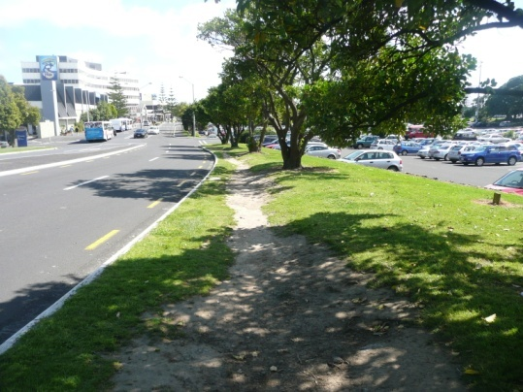


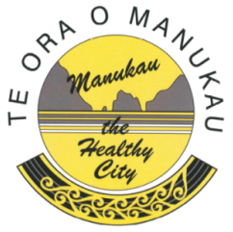
Manukau Built Form & Spatial Structure Plan
Plan developed and adopted by MCC
Health issues to be considered in implementation
Setting 50-year vision for urban, cultural, and social landscape
Block and street level
HIA conducted over 2008-09
Active transport, access, liveability and vitality, safety

Slide 12
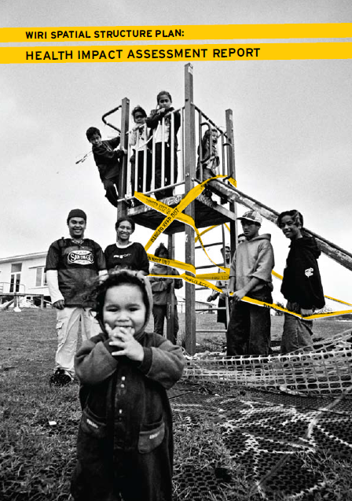
Wiri Spatial Structure Plan
Low-income suburb adjoining Manukau
Opportunity to review draft plan with community input
HIA led by Manukau the Healthy City, with Synergia providing support
HIA conducted May-September 2010
Access, housing, safety, economic potential

Slide 13

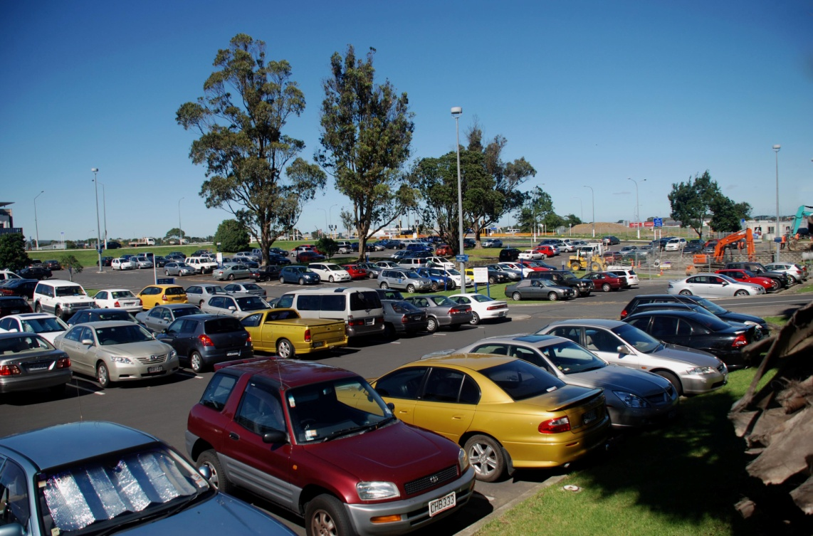
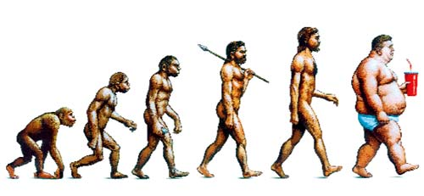
“First we form the cities,
and then the cities form us.”
(Jan Gehl, 2001)
The Economist, December 2009

Slide 14
Approaches

Slide 15
Common approaches
Health:
Public Health Service
District Health Boards
Primary Healthcare Organisations
Maori Providers
Social Sector:
Housing New Zealand
Work and Income NZ
Ministry of Education
Schools
Police
MSD
Scoping workshops
Stakeholder appraisal workshops
Whanau ora HIA processes
Key informant interviews
Report and recommendations
Most were 7-8 month processes with intensive periods
Local Government:
District/City/ Regional Councils
ARTA
(all now amalgamated)
Other:
Iwi
Pacific organisations
NZ Defence Force
NGOs

Slide 16
Exploring impacts and enablers
Potentially positive impacts
Potentially negative impacts
HIA
appraisal
Strategic/policy foundations
Actions
How do ensure those actions occur?
What needs to be in place to ensure positive outcomes?
Issues for vulnerable populations

Slide 17
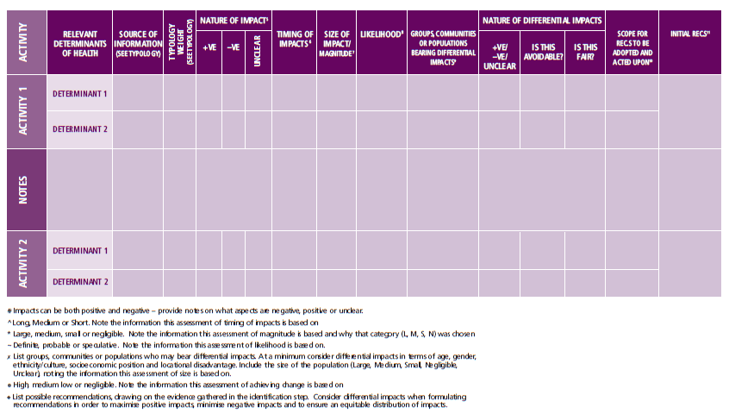
Analysis or engagement?
Source: Harris et al 2007

Slide 18
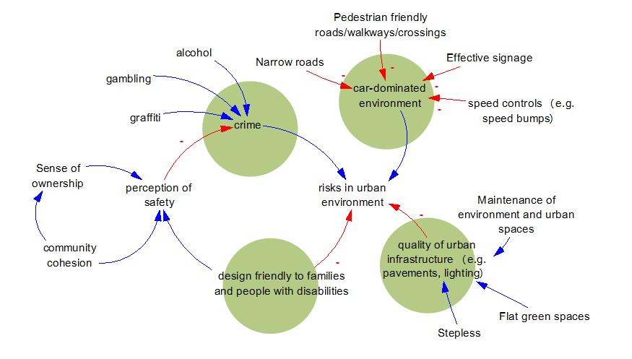
Consequences and causes

Slide 19
Outcomes achieved

Slide 20
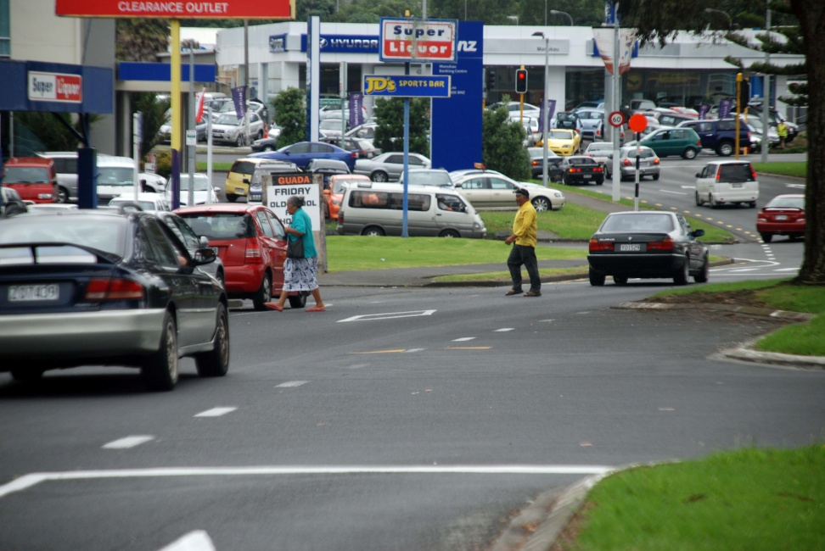
Direct effectiveness
Influencing decisions
  Forward planning in Manukau and Wiri
  Reappraisal of aspects of design (e.g. location of facilities, orientation of housing, mixture of land uses)
Local alliance-building
  Service planning around new housing areas

Slide 21
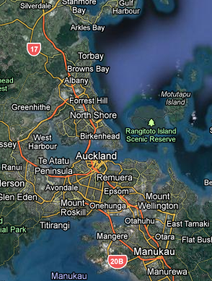
Generalised effectiveness
Broader understanding of dimensions of health and wellbeing, and links with urban and transport planning
Understanding of equity issues
Stakeholder-led recommendations
Engagement and support of elected councillors

Slide 22
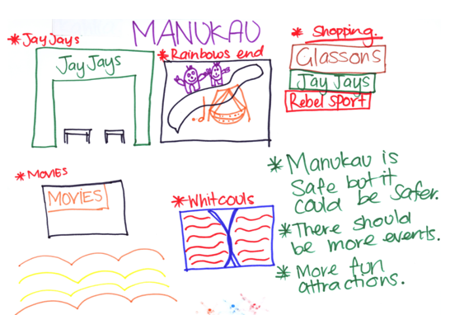
Input of vulnerable groups
Whanau ora HIA
  Dimensions of te ao Maori (cultural identity), kaitiakitanga (guardianship) of environment, toiora (healthy lifestyles), safe places for tamariki (children)
Children & young people’s input
  Use of city centre and park spaces
  Lack of unstructured play spaces
  Safety fears

Slide 23
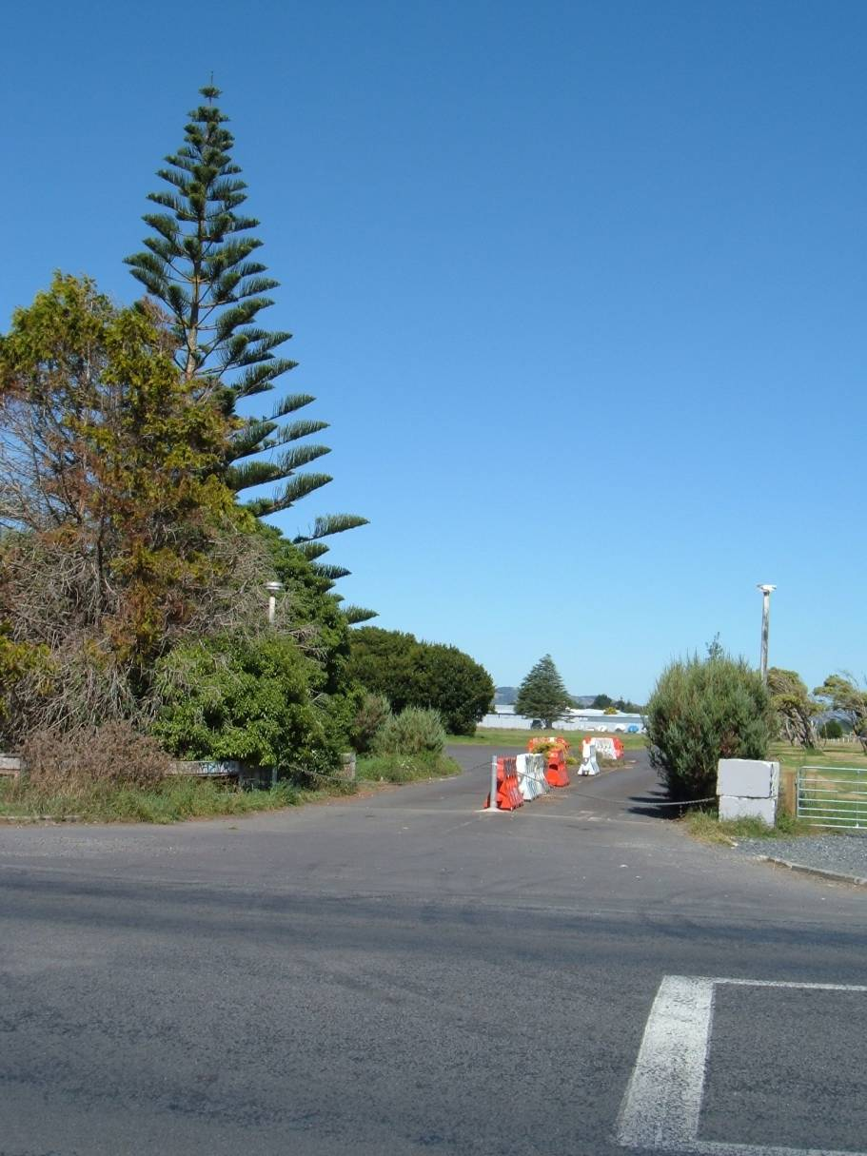

Limitations of effectiveness
Impact of economic environment constrained development in one area
Validated some directions of regional land transport strategy
  But some more challenging areas not picked up (e.g. whole of journey approaches for the transport disadvantaged)
Organisational change
  e.g. challenge of local government consolidation and public sector retrenchment
The Guardian, August 2011

Slide 24
Drivers of influence

Slide 25
Key drivers
Organisational commitment
  Active involvement of an advocate for HIA
Published research and evidence base
Early engagement with key staff members
Engagement process
  Broad range of sectors, communities and interest groups
Involvement of Māori organisations and communities through whānau ora HIA
  A ‘value add’ that other engagement processes lacked.
Fostering internal HIA capacity
  Shift from external consultant/researcher led to internally driven
Determination that engagement would be driven as much by developing directions forward as it was in identifying impacts
  Tangible future focus
  Allowed validation of recommendations

Slide 26
Acknowledgements
Hapai te Hauora Tapui Ltd
Ministry of Health HIA Support Unit
Auckland Regional Public Health Service
Auckland Regional Council
Manukau City Council
Papakura District Council
Counties Manukau District Health Board
Contact: Adrian Field, Synergia
adrian.field@synergia.co.nz
tel +64 21 529 805

